Slide 1
OSCE Dec 2016
QEH

Slide 2
Question 1
A gentleman fell from stairs and sustained left shoulder injury.

Slide 3
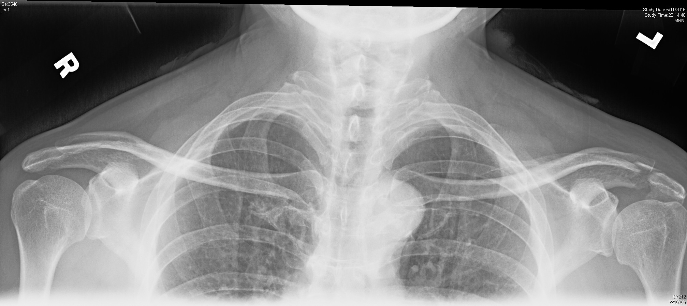
Name the pathology from the X ray?

Slide 4
Answer
Fracture of Lt acromion was seen

Slide 5
If you are not certain about the diagnosis, what supplemental views would be helpful?

Slide 6
Answer
Y view
Axial view
Apical oblique view

Slide 7
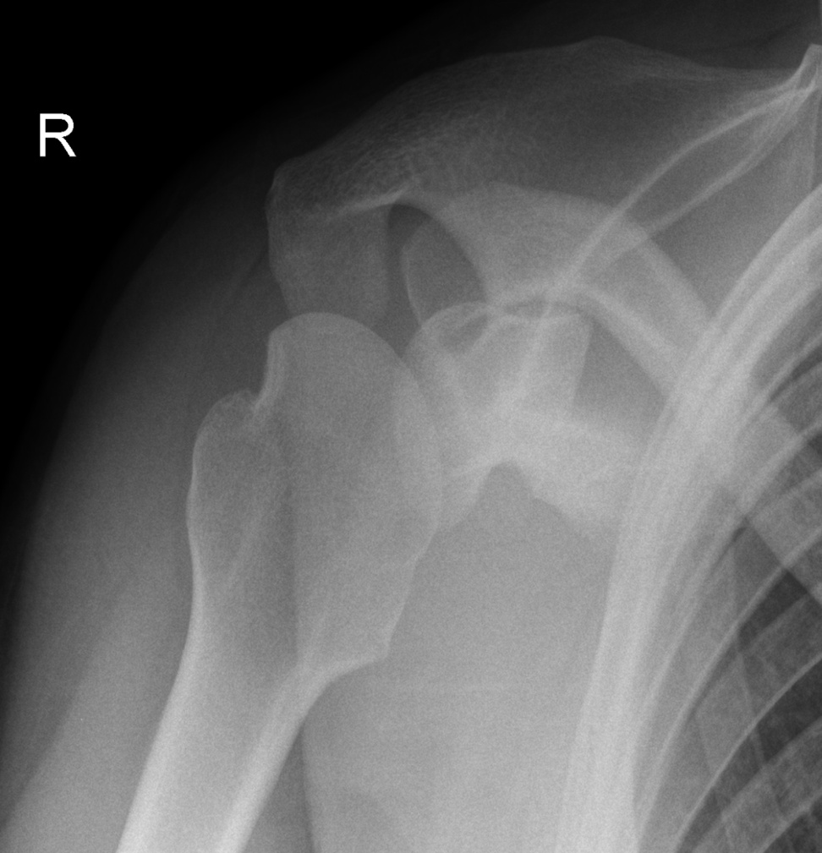
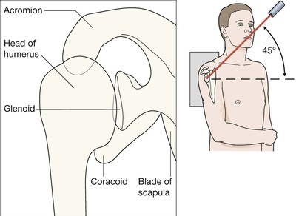
Apical oblique view

Slide 8
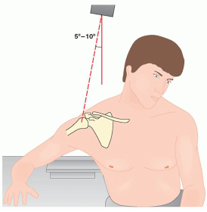
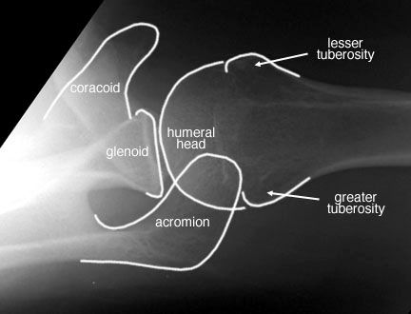
Axial view

Slide 9
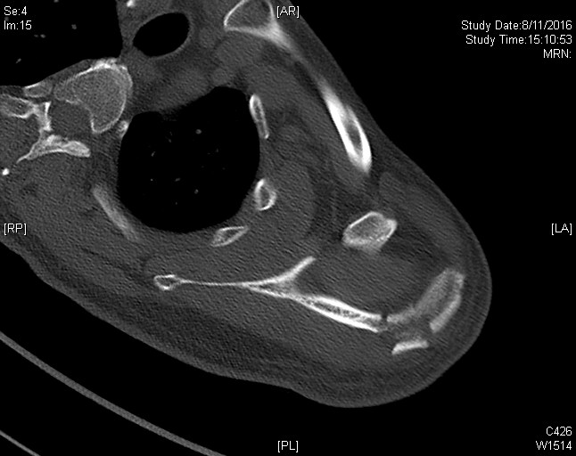
CT scan of the same patient

Slide 10
What is the potential soft tissue complication of this injury?
Answer: Rotator cuff impingement

Slide 11
How do you look for this complication on physical examination ?
Answer : 1. Neer’s test
( stabilize the scapula, palm pronation, forward flexion of shoulder, positive if pain reproduced)
2. Hawkins' test
( forward flexion of shoulder at 90 degree, elbow flexion at 90 degree, internal rotation of shoulder, positive if pain )

Slide 12
What are the treatment options of this injury?
Answer
Conservative treatment with immobilization
Operative treatment for displaced fracture with reduced subacromial space

Slide 13
Question 2
A 42 years old man presented with shortness of breath, sore throat and neck swelling. He had a medical history of diabetes and obesity. The oxygen saturation could be maintained at 93% on high flow oxygen.

Slide 14
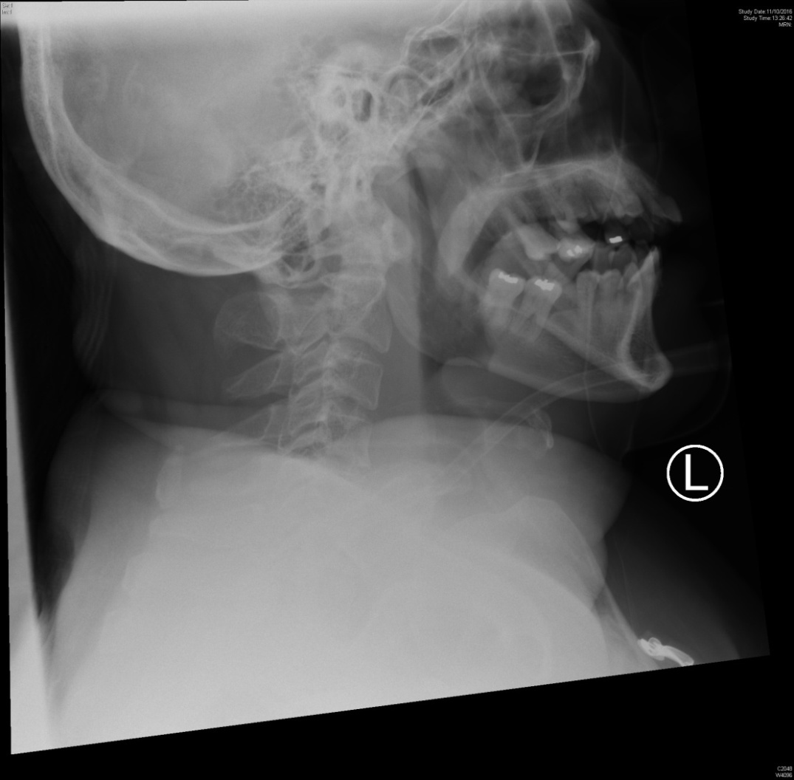
Describe two important findings on the X-ray

Slide 15
Answer
Swollen epiglottis
Thickened retropharyngeal soft tissue

Slide 16
How would you confirm your suspicion without an imaging technique (1 point)
It is a case of retropharyngeal abscess with concomitant epiglottitis.
Diagnosis can be confirmed by fiberoptic examination.

Slide 17
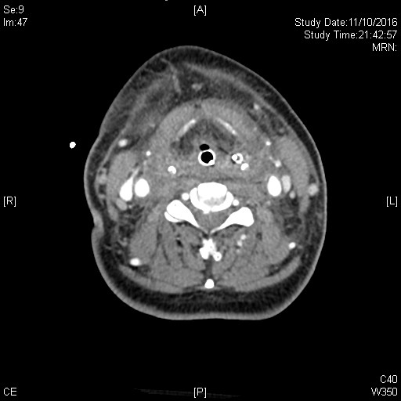
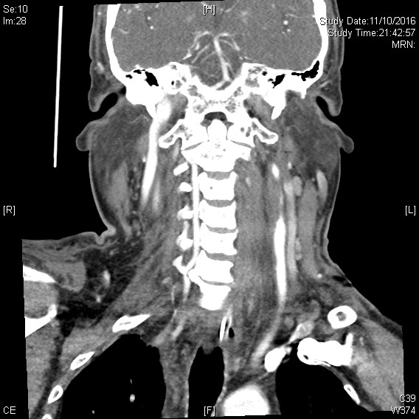
CT scan with contrast

Slide 18
Answer
CT scan with contrast was performed. A complication of this condition was found.
Name one important CT finding
What is the name of complication?

Slide 19
Lt internal julgular vein thrombosis
Lemierre’s syndrome

Slide 20
What are the two treatment options for this complication?
1. Treat the underlying infection
2. Anticoagulant ( controversial )
Consider in case of clot progression

Slide 21
If patient needed to transfer out for treatment, what should be done first?
Describe how you can perform the above management decision?
Answer: To secure airway
Awake fiberoptic intubation
Topicalize with LA on nostril, oropharynx and larynx
Optional use of sedation
Fiberoptic intubation via nasal routine
Sedation and paralysis
Surgical airway standby

Slide 22
Question 3a
A 72 years old male presented with a few days history of malaise and dizziness. He denied any chest pain. Vital signs were stable except the slow heart rate.
I-stat showed no significant electrolyte disturbance. ECG was performed.

Slide 23
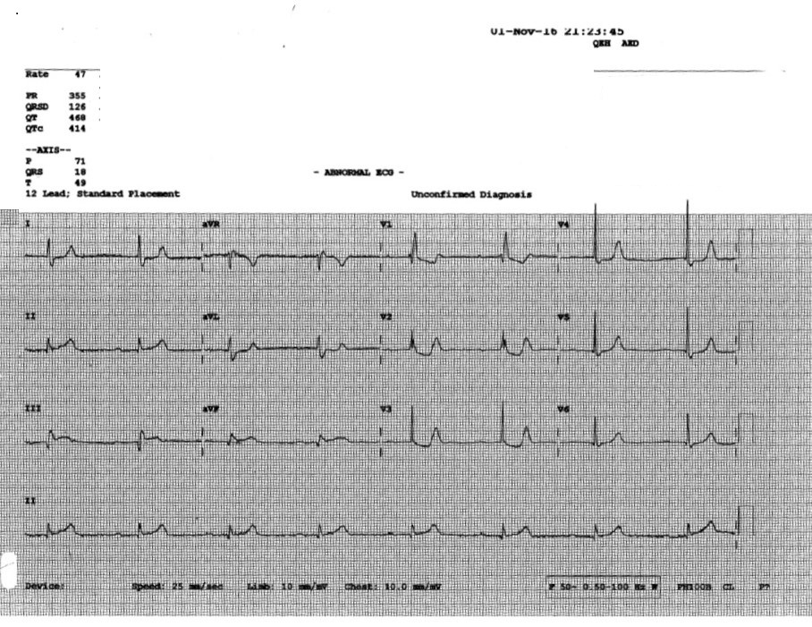

Slide 24
Describe the ECG finding and what is the diagnosis?
Sinus bradycardia
RBBB
First degree heart block
ST elevation at inferior lead
Diagnosis: STEMI with atypical presentation

Slide 25
Was thrombolytic therapy indicated for this patient?
Thrombolytic therapy is generally not indicated for STEMI with very atypical presentation.
Difficult to ascertain the onset time
Antiplatelet/ LMWH/ PCI / Risk factors control are still useful.
Outcome of patient: Coro showed total occlusion of RCA/ PCI done.

Slide 26
Question 3b
A 45 years old man presented with chest pain. Acute coronary syndrome was suspected clinically. ECG was performed.

Slide 27
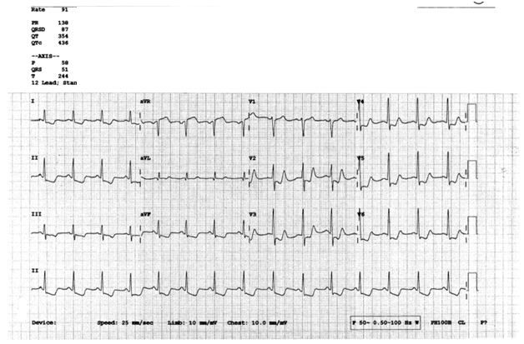

Slide 28
What are the ECG findings? What is the implication ?
Diffuse ST depression at V2- V6, inferior lead & lateral lead
STE at aVR
In the context of ACS, it indicates LMCA or proximal LAD occlusion or severe triple vessel diseases.
Associated with poor prognosis
Outcome of patient: Coro showed coronary artery dissection at LMCA/ succumbed shortly

Slide 29
What ECG finding will prompt you to look for RV or posterior wall infarct?
RV infarct : inferior STEMI or STE at V1
Posterior wall infarct: STD V1 – V3

Slide 30
Question 4
This question is concerning about fracture hip.
Four patients presented with hip contusion. Their x ray were shown.
Please point out the fracture site on each X ray.

Slide 31
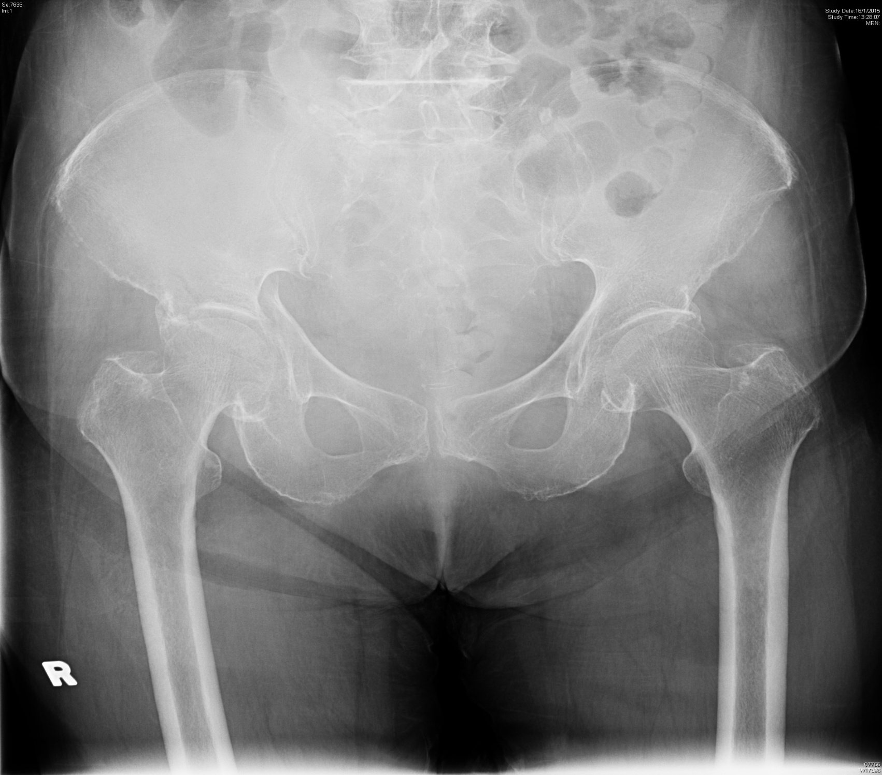
Patient A

Slide 32
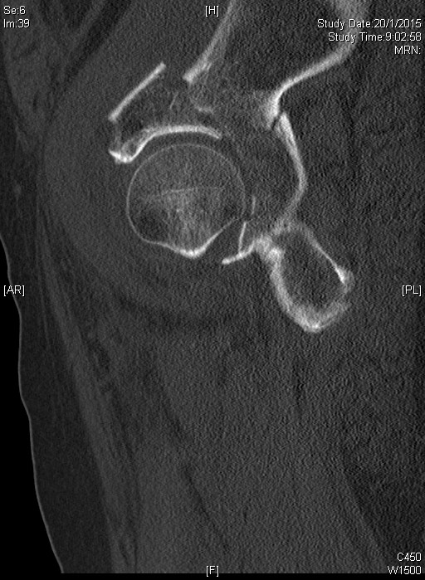
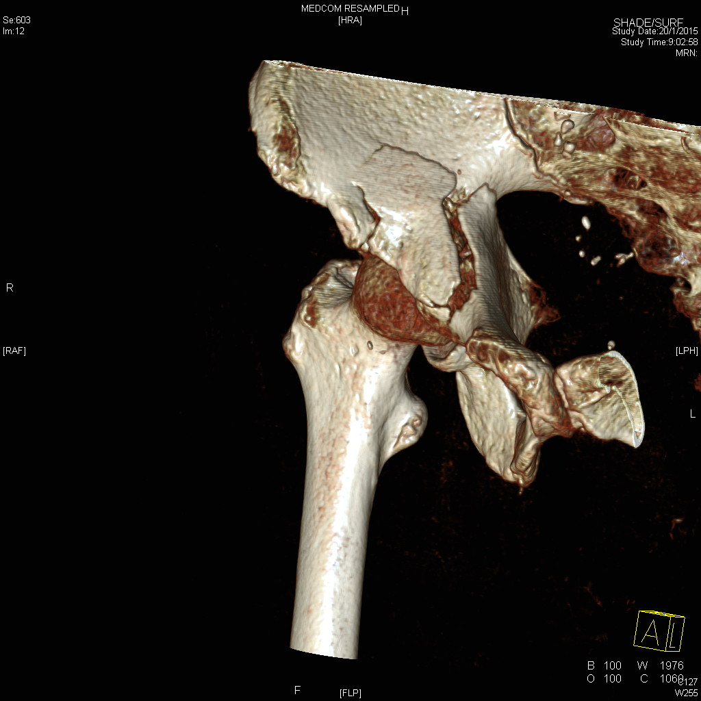
Answer: # Rt actebulum

Slide 33
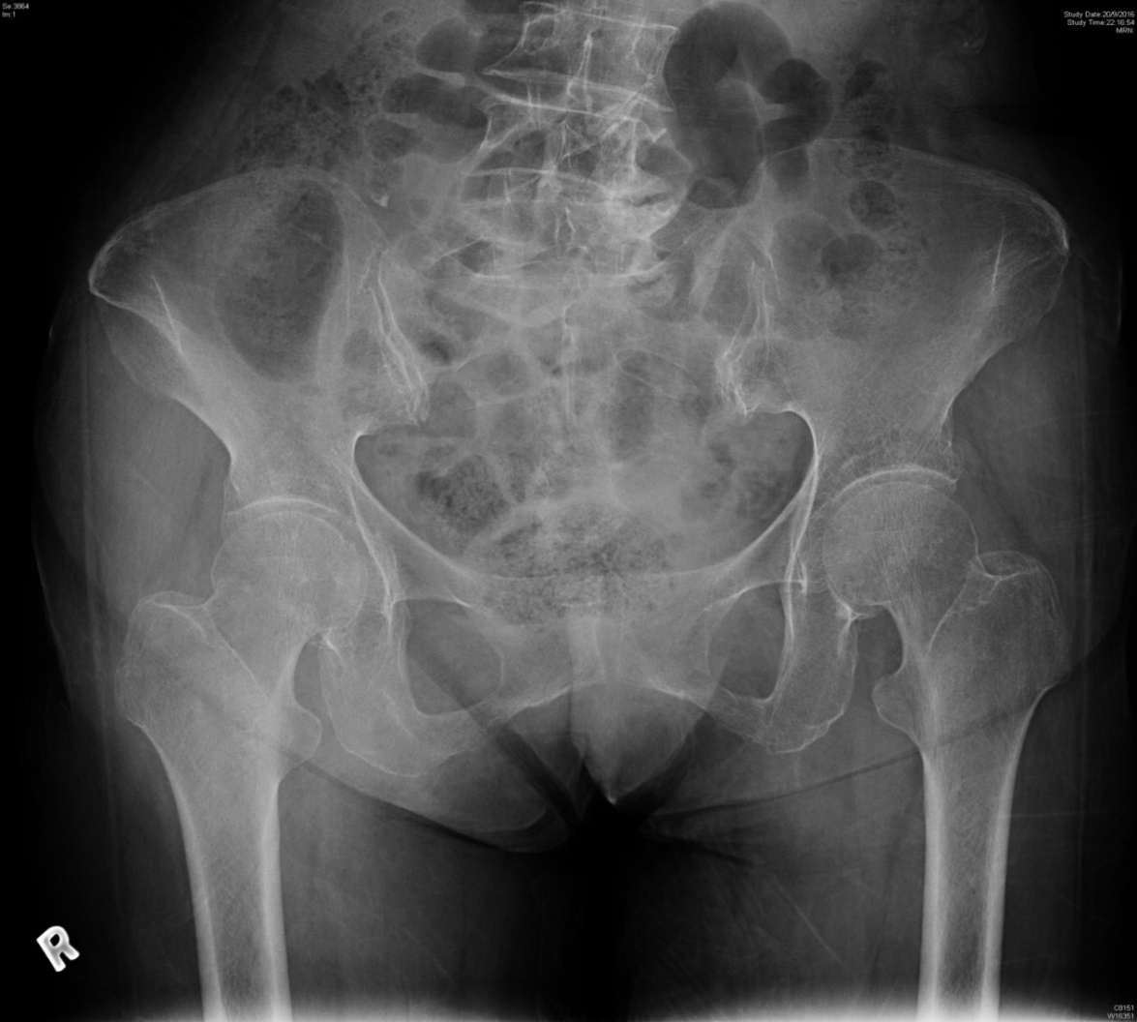
Patient B

Slide 34
Answer : Impacted fracture Rt neck of femur

Slide 35
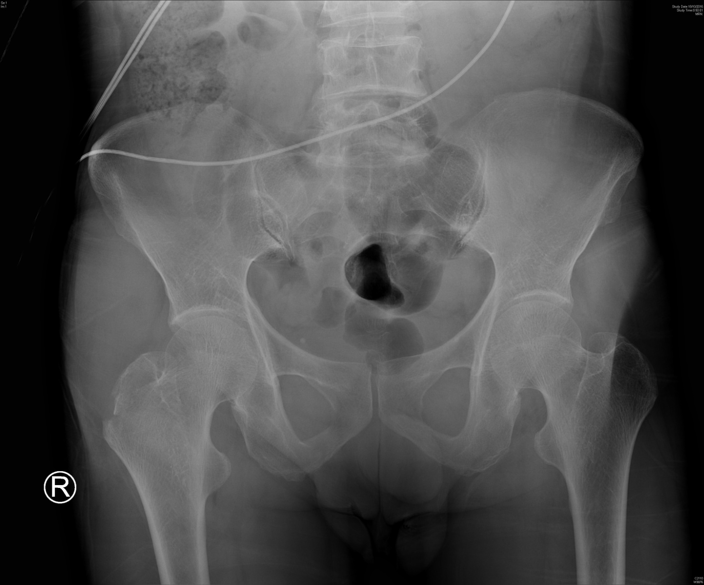
Patient C

Slide 36
Answer: Fracture Rt greater trochanter

Slide 37
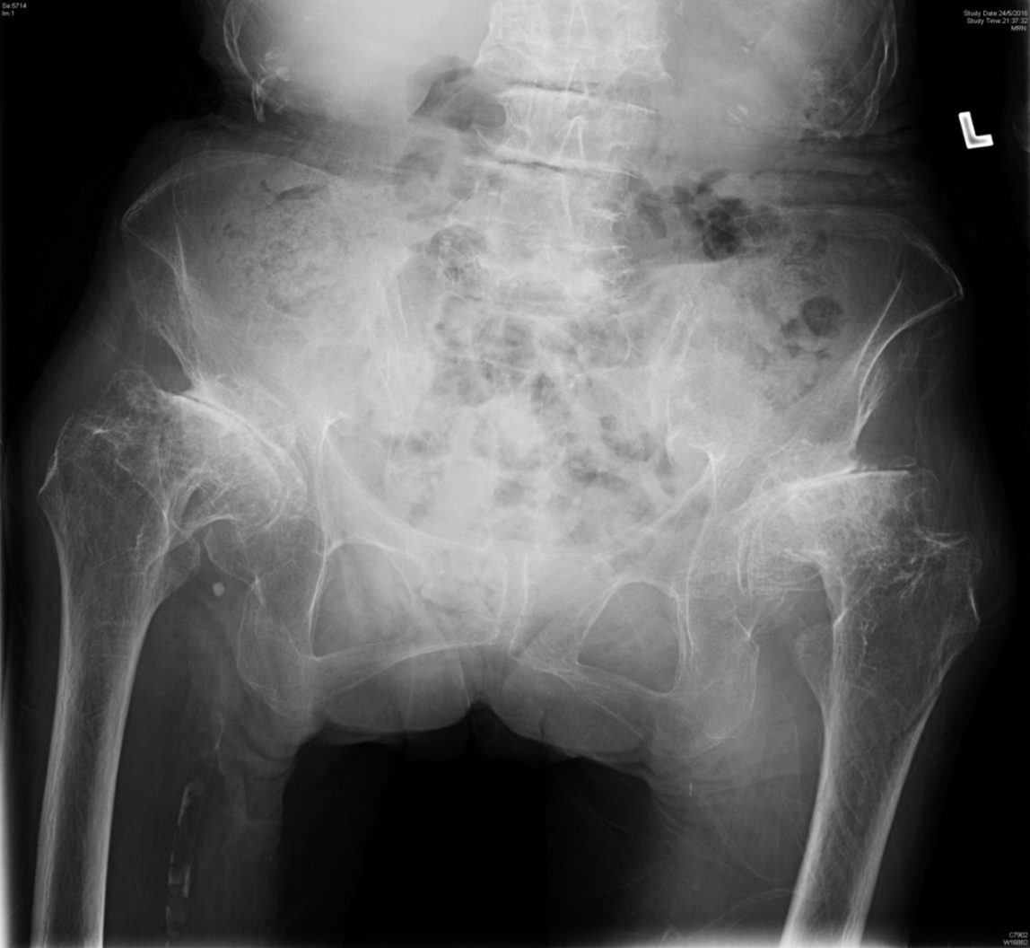
Patient D

Slide 38
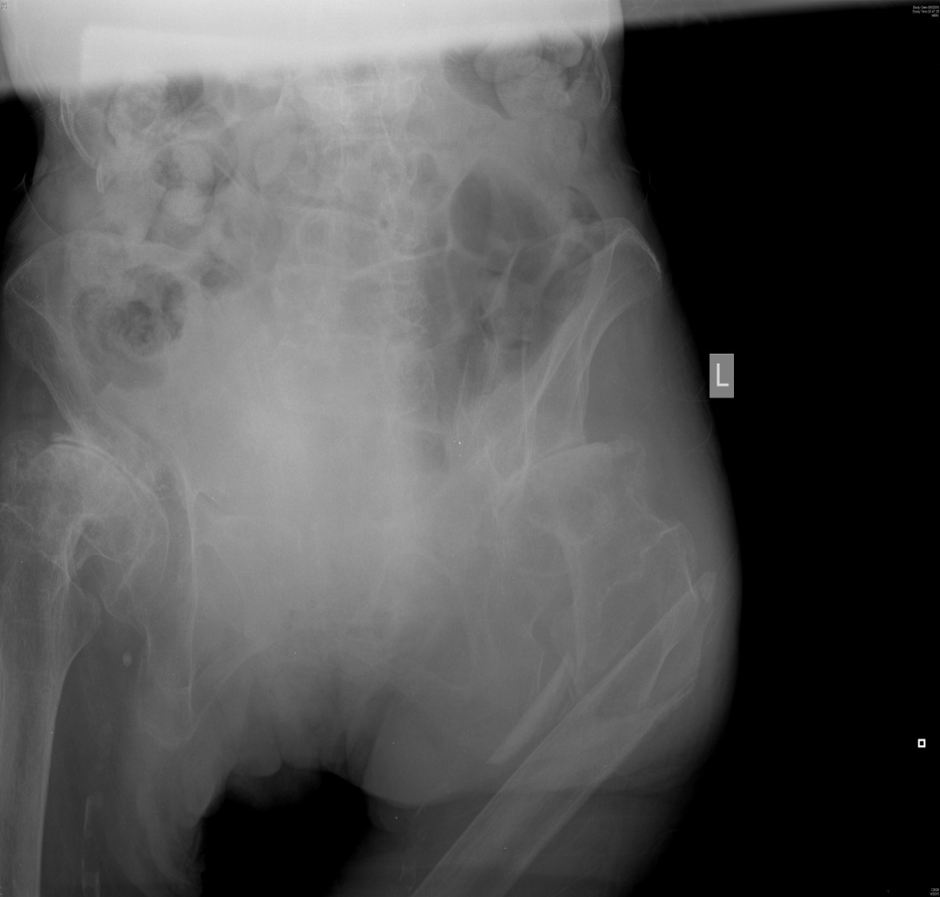

Answer : Lt subtronchanteric fracture X ray repeat later

Slide 39
What is the alternative method of pain relief apart from systemic analgesic?
Regional nerve block e.g. femoral nerve block

Slide 40
For fracture neck of femur, what is the most worried ( orthopedics) complication?
AVM of femoral head

Slide 41
What are the operative treatment options for displaced fracture femoral neck in young patients and geriatric patients respectively?
Geriatric patients: Arthroplasty
Young patients: prompt internal fixation to preserve their own femoral neck.
Delayed diagnosis of fracture NOF is undesirable.

Slide 42
Question 5
A 20-year-old lady traveled to Kenya for 10 days, returned since one week ago, presented to A&E with fever and headache for 3 days. There was also vomiting and diarrhea. GCS 15, BP 130/80mmHg, pulse 115bpm. Temp 41.3C.

Slide 43
Name four differential diagnoses in relation to the travel history?
Dengue fever
Typhoid fever
Leptospirosis
Meningitis
Influenza
Chikungunya

Slide 44
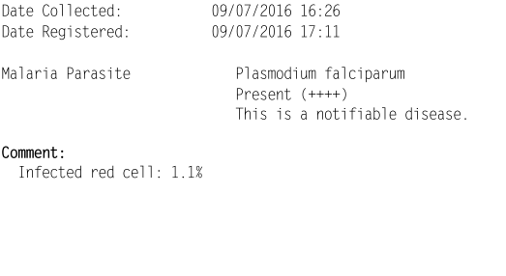
Screening for malaria was ordered

Slide 45
How do you interpret the parasite count ? It is low or high parasite densities ?
Parasitemia > 4 % associated with higher mortality in non immune persons

Slide 46
How would you manage this patient?
Resuscitation
Look for any evidence of complicated malaria (prostration, impaired consciousness, convulsion, shock, jaundice, haemoglobinuria, severe anemia, hypoglycemia, metabolic acidosis, renal or liver function impaired, high parasitemia>5%)
If patient is critically ill and admission to medical would be delayed, start IV artesunate 2.4mg/kg with oral mefloquine 1000mg in A&E
Admit the patient to medical ward (no need isolation)
Report NDORS

Slide 47
What are the effect of malaria on mother and fetus?

Slide 48
Answer
Effect of malaria on pregnancy
Mother: at higher risk of severe illness
Fetus : miscarriage, low birth weight & premature delivery

Slide 49
What are the recommended drug treatment for malaria (mainly P. falciparum) in pregnancy?

Slide 50
Treatment of malaria( P. falciparum) during pregnancy
Tetracycline and Primaquine are contra-indicated
Uncertain safety of Artermisinin at first trimester
For all severe infection, give Artermisinin
For uncomplicated cases, Quinine is preferred for first trimester and Artermisinin for second and third trimester.
Courtesy of Dr Kwong WY for her preparation on this OSCE question about malaria

